Slide 1
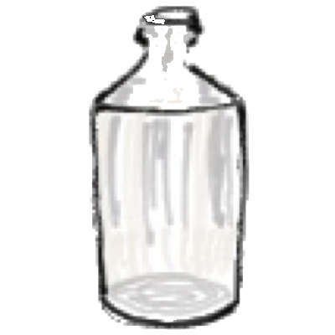
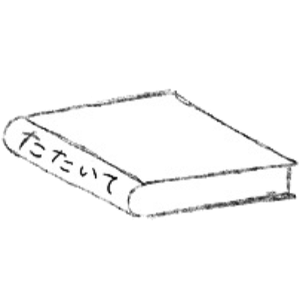
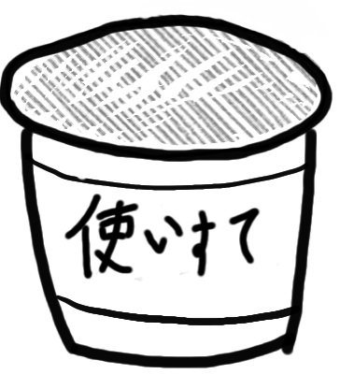
Storage:
Liquor
Avoid strong energies: Sun,
odors, heat.
3. Evaluate remedy effectiveness
3 days after taking the remedy.
Anti-bacterial
1. Prepare
A little
2. The symptoms discussed with
your homeopath appear.
Remedy
１−２pellets
Begin remedy taking
d
The patient or others record symptomso。
Remedy
Evaluation
Cap
Mind &
Body
symptoms
Effective
No effect
ラベル
Everyday before
remedy taking
Cap
Talk to your
homeopath
To find another remedy
Succusset
10 times
Continue remedy taking
until symptoms
disappear
1 drop
Contact：
A mouthful
of water
tokyohomeopathy.com
Ellen Madono
真殿エレン

